Slide 1


Slide 2
Product Concept
Notes:
1 -Jeff

Slide 3
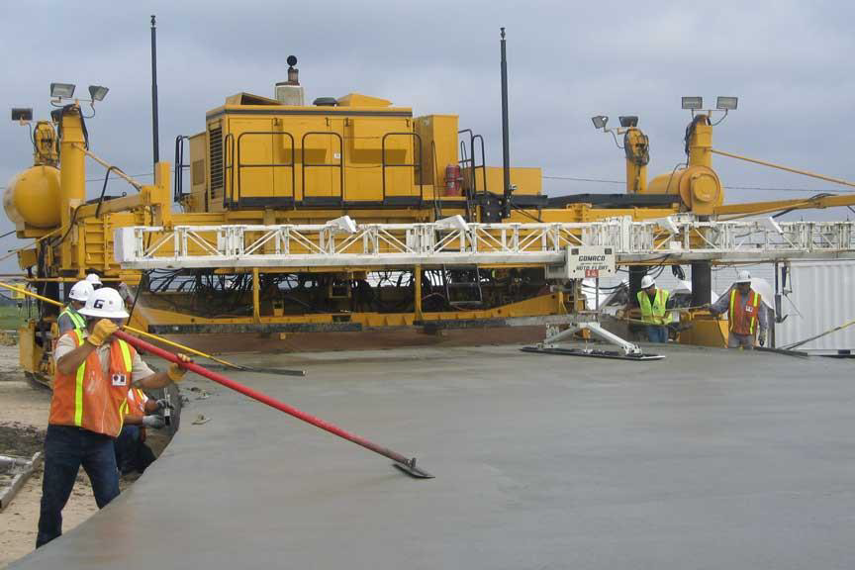
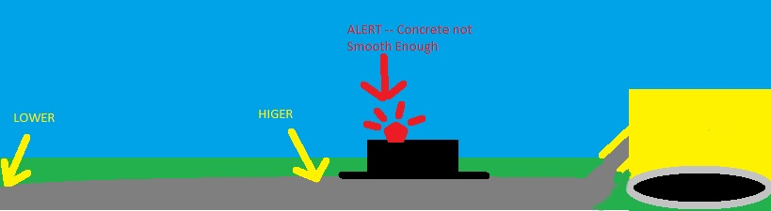
Rear view of a typical paver
Notes:
1 -Jeff

Slide 4
Product Definition
The Sliding Profiler is a wet concrete bump detection product that aggregates data from many sensors to determine the probable smoothness of the freshly laid road. Before the concrete has dried, the operators will know if the concrete has met the state requirement for smoothness of concrete roads.
Notes:
1 -Jeff

Slide 5
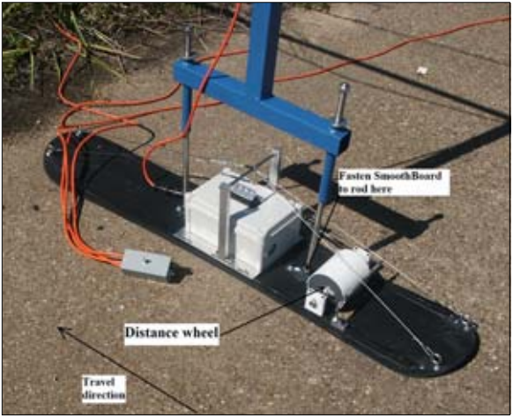
Previous Product
Notes:
1 -Jeff

Slide 6
Key Critical Requirements
The device shall not operate after a critical error
The device shall be able to measure the travel distance of the platform
The device shall be able to measure the inclination of the platform from a calibration point
The device shall generate operational data from the raw data of the sensors
The device shall detect bumps in concrete pavement while the product is floating on the freshly poured concrete surface
The device shall be able to operate in extreme temperatures
The client application shall calibrate sensors
The client application shall configure the PIC microcontroller
The product shall visually indicate a bump using a beacon light
The product shall be light enough to float on top of the concrete pavement
The product shall not disturb the wet concrete
The slider shall not accumulate cement
Notes:
1 -Jeff

Slide 7
User Interface Requirements
Notes:
1 -Jeff

Slide 8
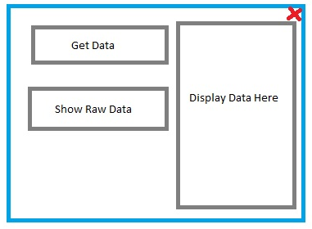
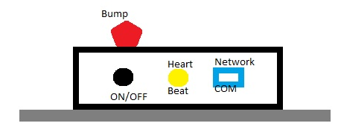
User Interfaces
Client Application
Hardware Interface
Notes:
1 -Jeff

Slide 9
UI Requirements
The device must turn on/off easily
The device shall visually indicate error conditions
The device shall visually indicate when it is operating normally
The product shall visually indicate a bump using a beacon light
The client application must run on a PC
The client application shall display operational data
The product shall have a user-friendly client application
Notes:
1 -Jeff

Slide 10
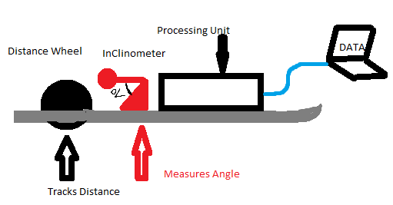
Inputs and Outputs
ITEM | Description | Use | Input or Output
ON/OFF | Turns on and off | Turns on and off | INPUT
Client Application | Software Application | View analyzed and processed data | OUTPUT
Warning Light | A bright flash able light | Notify a bump is detected | OUTPUT
Heart Beat | A soft flashing light | Notify continuous operation | OUTPUT
Notes:
1 -Jeff

Slide 11
Packaging Requirements
The Sliding Profiler shall arrive completely assembled
Software shall be customer installable
The product shall come with a storage solution
Notes:
2 -Lloyd
The storage box prevents the Product from outside hazards. Also, the storage solution helps the product to be transported easily.

Slide 12
Performance Requirements
The device shall perform in real-time
The device power source shall be provided externally
The product shall not disturb the wet concrete
The slider shall not accumulate cement
The system shall store operational data
The stored data shall be accessible by user
The product shall operate in extreme temperatures
The client application shall calibrate sensors
Notes:
2 -Lloyd

Slide 13
Safety Requirements
The product shall have a power source interruption
The product shall have no sharp edges
The product shall have an electric shock protection
Notes:
2 -Lloyd

Slide 14
Maintenance and Support Requirements
The product shall be easy to clean
The product shall be returned to the supplier after a critical malfunction
The product shall come with a support manual
Notes:
2 -Lloyd

Slide 15
Other Customer Requirements
Notes:
2 -Lloyd

Slide 16
High Priority Requirements
The Device shall be able to measure the internal temperature of the electronics housing.
The Device shall visually indicate when it is operating.
The Device shall visually indicate error conditions.
The Device shall use an embedded PIC microcontroller w/ networking.
Configuration processes shall be obscured from the end-user.
The Device must turn on/off easily.
The Device shall store operational data.
The Product shall have a user-friendly client application.
The client application must run on a PC.
Notes:
2 -Lloyd

Slide 17
Medium/Low Priority Requirements
The Product shall come with a storage solution.
The Electronics shall be detachable from the Platform.
The Device shall transfer operational data to the client application in real-time.
The client application shall display operational data.
The client application shall read stored data.
The product shall have GPS to track the bump location.
Notes:
2 -Lloyd

Slide 18
Acceptance Criteria
Before the Sliding Profiler can be fully accepted, each feature and function required by the sponsor must be demonstrated and or inspected.
Example: Verify the device visually signals when a bump is detected by light
Verification Procedure: The sponsor will verify the device signals by light when a bump is detected through a live demonstration under a controlled environment to produce a specific result.
Notes:
3 -Tyler

Slide 19
Use Cases
Notes:
3 -Tyler

Slide 20
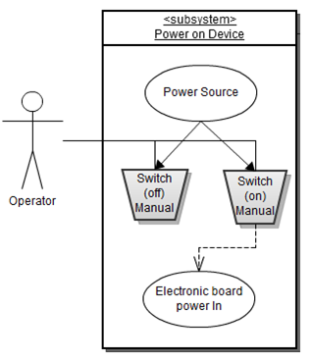
Notes:
3 -Tyler

Slide 21
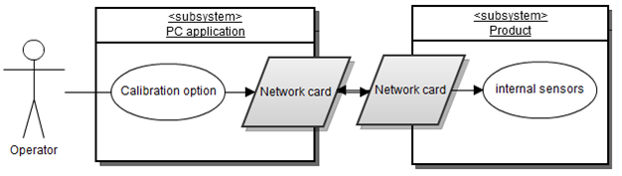
Calibrating Sensors
Notes:
3 -Tyler

Slide 22
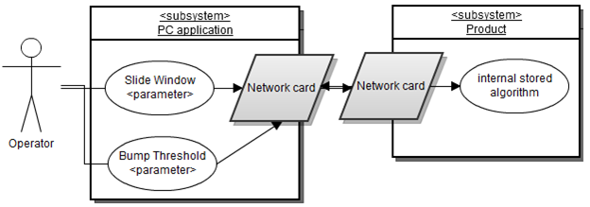
Configure Product
Notes:
3 -Tyler

Slide 23
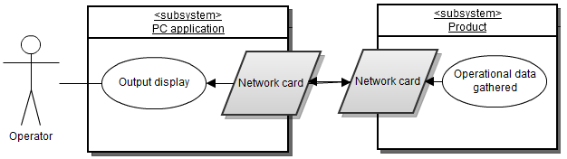
Data Retrieval
Notes:
3 -Tyler

Slide 24
Feasibility Assessment
Notes:
4 -CM

Slide 25
Scope Analysis
Scope Analysis: The scope of work for all critical requirements is reasonable, and prototyping of these by the deadline date appears feasible.
Notes:
4 -CM

Slide 26
Research
Looked at two previous projects on Sliding Profilers. Our sponsor, Dr. Walker, pointed out their mistakes.
Bump detection algorithm
Weight to surface area ratio
Data acquisition and SP program procedure
SP data server and client module
Notes:
4 -CM

Slide 27
Technical Analysis
Client application
Hardware design
Mechanical design of the platform
Server-Client communications
Algorithms
Notes:
4 -CM

Slide 28
Cost Analysis
Components | Low Price ($) | High Price ($)
Inclinometer | 0 | 900
Temperature Sensors | 0 | 5
Encoder | 0 | 5
Microcontroller Unit | 0 | 5
A/D Convertor | 0 | 250
GPS | 40 | 100
PCB + RS232 Interface | 15 | 35
Network chip | 10 | 45
SD Card | 3 | 20
Enclosure | 0 | 50
Platform | 40 | 150
Distance Wheel | 0 | 20
PC Client | 0 | 250
Total | 108 | 1515
* These costs include the option of re-using parts from previous project
Notes:
4 -CM

Slide 29
Resource Analysis
Team Structure
Two CpE and two CS students
Resource Allocation
Hardware Design - Two CpE
Algorithms - Two CS
Client Application - All Members
Server-Client Application - All Members
Platform Design - All Members + Sponsor
Notes:
4 -CM

Slide 30
Schedule Analysis
Comparison of various estimation methods
Aggressive Conservative
Size and Productivity 6 months 8 months
McConnell Tables 7 months 9 months
Rule of Thumb 8 months 9 months
CoCoMo 8 months 9 months
Function Points/Jones’s Not Used
Sanity Test (Weiss & Wysocki, 1992)
E = (O + 4M + P) / 6, where O = optimistic, M = Nominal, P = Pessimistic
Therefore, our E = (6 + 32 + 9) / 6 = 47/6 = 7.8 months
Notes:
4 -CM

Slide 31
Questions?

